Slide 1
EMAIL SPAM DETECTION
Guided by :-
Kiran V K
Assistant Professor
GROUP NO:5
Anand Sekhar P C
Arya S Dhrisya S Archana P Nair

Slide 2
CONTENT
Problem Definition
Objective of the Work
Feasibility Analysis
Tool Specification
Methodology
Data Collection
Partial Implementation
Literature Review
Reference
2

Slide 3
PROBLEM DEFINITION
Importance of Email:
Email has become a fundamental tool in both personal and professional environments, facilitating communication, collaboration, and decision-making.
However proliferation of spam emails presents several challenges
Proliferation of Spam:
What is Spam?: Unsolicited emails, often sent in bulk, that can range from advertisements to malicious content.
Volume: Over 50% of global email traffic consists of spam, according to recent studies.
3

Slide 4
PROBLEM DEFINITION
Challenges Posed by Spam:
Reduced Productivity: Users spend significant time sorting, identifying, and deleting spam from their inboxes, leading to loss of focus and efficiency.
Security Threats: Spam often includes phishing links, malware attachments, or scams, putting personal data, financial information, and organizational security at risk.
User Frustration: Continuous encounters with spam can lead to frustration and a lack of trust in email as a reliable communication tool.
4

Slide 5
OBJECTIVES OF THE WORK
To create an efficient spam detection model for individuals or organizations who want to build their own personalized email system.
Specific Goals:
Develop a Spam Detection Model:
Create a machine learning-based solution using Logistic Regression to classify emails as spam or ham.
Preprocess Email Data:
Perform text cleaning, tokenization, and feature extraction to prepare the email data for analysis.
Train and Evaluate the Model:
Use labeled datasets for training and test the model to measure accuracy and performance.
Optimize the Model:
Continuously adjust model parameters to improve accuracy and reduce false positives and negatives.

Slide 6
FEASIBILITY ANALYSIS
Technical Feasibility:
Logistic Regression Suitability: Logistic Regression is ideal for binary classification tasks, making it a suitable algorithm for distinguishing between spam and ham emails.
Availability of Libraries: Libraries like Scikit-learn, Numpy, and Pandas provide robust tools for data preprocessing, model training, and evaluation.
Dataset Availability: Public datasets, such as those available on Kaggle, offer large labeled datasets of spam and ham emails, enabling effective model training and testing.

Slide 7
FEASIBILITY ANALYSIS
Operational Feasibility:
Implementation Complexity: Logistic Regression is relatively easy to implement and interpret compared to more complex algorithms, making it accessible even to small teams with limited machine learning expertise.
Scalability: The model can be scaled to handle large volumes of emails, allowing for integration into real-time spam detection systems for personalized email services.

Slide 8
FEASIBILITY ANALYSIS
Economic Feasibility:
Cost-Effective Development: Since open-source libraries and datasets are widely available, the cost of developing the model remains low. Computing resources for training Logistic Regression models are minimal compared to more complex algorithms like deep learning.
Low Maintenance Costs: Logistic Regression models are simple and require less maintenance, reducing the long-term costs of deploying and maintaining the spam detection system.

Slide 9
TOOL SPECIFICATION
Programming Language:
Python:
Chosen for its rich ecosystem of libraries tailored for machine learning and data analysis, as well as ease of use.
Key Libraries and Tools:
NumPy:
Provides support for large, multi-dimensional arrays and matrices, along with a wide collection of high-level mathematical functions to operate on these arrays. Used for numerical operations and efficient data manipulation.
Pandas:
Used for data manipulation and analysis. It provides data structures like DataFrames, which are essential for handling tabular data (e.g., email datasets in CSV format).

Slide 10
TOOL SPECIFICATION
Key Libraries and Tools:
Scikit-learn:
train_test_split : Utility to split data into training and testing sets.
accuracy_score : For evaluating the model's classification performance by comparing predicted vs actual values.
TfidfVectorizer : Converts text data into numerical feature vectors using the TF-IDF (Term Frequency-Inverse Document Frequency) .This will transform email content into a format suitable for the Logistic Regression model.

Slide 11
TOOL SPECIFICATION
Developer Environment :
Jupyter Notebook:
Preferred for interactive coding, allowing you to write, test, and visualize code incrementally. It’s great for experimenting with models and debugging.
Data Set :
Kaggle Email Dataset:
Provides labeled datasets of spam and ham emails, which are essential for training and testing the spam detection model.

Slide 12
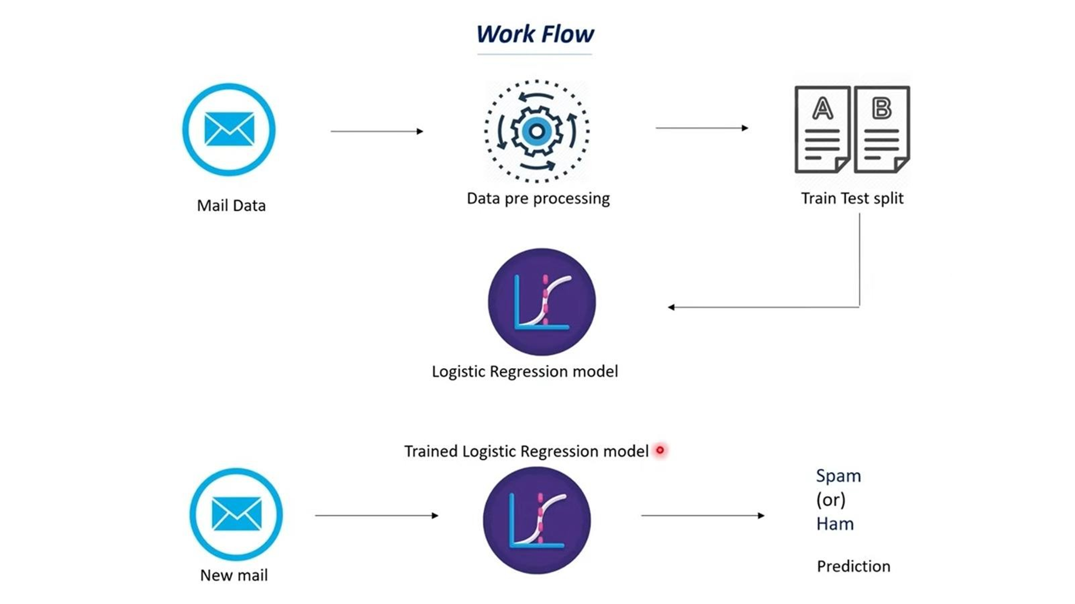
METHODOLOGY

Slide 13
METHODOLOGY
Data Collection :
The dataset contains email messages with labels indicating whether they are spam or ham.
It has two features
Category: Label indicating if the email is spam or ham
Message:Content of the email message.
Data Preprocessing :
Loading the Dataset:
Imported mail_data.csv into a Pandas DataFrame.
Replaced null values with an empty string.
Label Encoding:
Converted spam labels to 0 and ham labels to 1.

Slide 14
METHODOLOGY
Splitting Data :
Feature and Label Separation:
Features (X): Email messages (text content).
Labels (Y): Binary labels (0 for spam, 1 for ham).
Train-Test Split:
80% Training Data, 20% Testing Data.
Text Feature Extraction
TF-IDF Vectorization:
Used TfidfVectorizer to convert text into numerical feature vectors.
Removed English stop words and converted text to lowercase.
Transformation:
Applied vectorization on both training and testing data.

Slide 15
METHODOLOGY
Logistic Regression Model
Custom Implementation:
Logistic_Regression class with methods for:
Initialization: Set learning rate and iterations.
Training (fit): Compute weights using Gradient Descent.
Prediction (predict): Use sigmoid function to predict output.
Model Training
Training Process:
Input: TF-IDF feature vectors of training data.
Output: Trained model parameters (weights and bias).

Slide 16
METHODOLOGY
Model Evaluation
Accuracy on Training Data:
Calculated using accuracy_score metric from sklearn.
Display the accuracy achieved by the model on training data.
Predictions on New Data
Test with New Samples:
Converted new email message into feature vectors.
Predicted if it is Spam or Ham.
Display the prediction output.

Slide 17
DATA COLLECTION
The data set “ mail_data.csv “ was taken from kaggle
It contains email messages with labels indicating whether they are spam or ham.
It has two features
Category: Label indicating if the email is spam or ham
Message:Content of the email message.

Slide 18
PARTIAL IMPLEMENTATION
The model was constructed and was trained using the data set.
The gives an accuracy score of 0.86 on test_data set.

Slide 19
LITERATURE REVIEW
Paper 1 - Efficient Spam Email Classification Using Machine Learning Algorithms
Authors: Pallavi N and Dr. P. Jayarekha
Approach: Applied multiple classifiers including Decision Tree, Random Forest, and Logistic Regression on a Kaggle dataset.
Methods: Data pre-processing (removing stop words and special characters).Comparative analysis using metrics like accuracy, RMSE, MAE, etc. Results: Naïve Bayes outperformed other models, showing its robustness in spam email classification
Paper 2 - Machine Learning-Based Spam Email Detection Using Logistic Regression
Authors: Livia Shreenithi S A, Yougandar S V, N Jayapandian
Approach: Focus on Logistic Regression for binary classification of spam and non-spam emails. Extracted features from email content (word frequencies, header data).Compared Logistic Regression with other classifiers like Naïve Bayes and SVM.
Results: Logistic Regression demonstrated competitive performance, excelling in accuracy and interpretability. Emphasis on future exploration of ensemble methods and deep learning to enhance detection accuracy

Slide 20
LITERATURE REVIEW
Paper 3 - Email Spam Detection Using Machine Learning Algorithms
Authors: Nikhil Kumar, Sanket Sonowal, and Nishant
Approach: Tested various algorithms: Naïve Bayes, SVM, Decision Tree, Random Forest, and K-Nearest Neighbour. Dataset collected from Kaggle with pre-processing techniques like tokenization and Bag of Words.
Results: Naïve Bayes and Random Forest exhibited the best precision and accuracy. Ensemble methods like bagging and boosting showed enhanced performance, particularly in reducing variance.
Paper 4 - Detecting Spam E-mails with Content and Weight-Based Binomial Logistic Model
Authors: Richa Indu and Sushil Chandra Dimri
Approach: Emphasized a binomial logistic model focusing on word frequency and content-based analysis. Comparison with classical algorithms like Logistic Regression and Naïve Bayes.
Results: Logistic regression performed well in identifying spam patterns, with scope for improvements using deeper feature extraction methods​

Slide 21
REFERENCES
R. Indu and S. C. Dimri, "Detecting Spam E-mails with Content and Weight-Based Binomial Logistic Model," in Journal of Web Engineering, vol. 22, no. 7, pp. 939-959, October 2023, doi: 10.13052/jwe1540-9589.2271.
N. Kumar, S. Sonowal and Nishant, "Email Spam Detection Using Machine Learning Algorithms," 2020 Second International Conference on Inventive Research in Computing Applications (ICIRCA), Coimbatore, India, 2020, pp. 108-113, doi: 10.1109/ICIRCA48905.2020.9183098.
L. S. S. A, Y. S. V and N. Jayapandian, "Machine Learning Based Spam E-Mail Detection Using Logistic Regression Algorithm," 2023 IEEE International Conference on ICT in Business Industry & Government (ICTBIG), Indore, India, 2023, pp. 1-6, doi: 10.1109/ICTBIG59752.2023.10455970.
P. N and P. Jayarekha, "Efficient Spam Email Classification Using Machine Learning Algorithms," 2023 7th International Conference on Computation System and Information Technology for Sustainable Solutions (CSITSS), Bangalore, India, 2023, pp. 1-6, doi: 10.1109/CSITSS60515.2023.10334171.

Slide 22
THANK YOU

